Slide 1
Amity School of Engineering & Technology
Programme: B.Tech, Semester- III
Data Structure Using C
Notes:
Amity Business School

Slide 2
Module-V
Searching & Sorting Techniques

Slide 3
Syllabus
Insertion Sort, Bubble sort, Selection sort, Quick sort, Merge sort, Heap sort, Partition exchange sort, Shell sort, Sorting on different keys, External sorting. Linear search, Binary search, Hashing: Hash Functions, Collision Resolution Techniques.

Slide 4
In this session
We will talk about
Linear search
Binary search

Slide 5
What is algorithm and Algorithm design?
An Algorithm is a Step by Step solution of a specific mathematical or computer related problem.
Algorithm design is a specific method to create a mathematical process in solving problems.

Slide 6
Sorted Array
Sorted array is an array where each element is sorted in numerical, alphabetical, or some other order, and placed at equally spaced addresses in computer memory.
0 | 1 | 2 | 3
10 | 20 | 30 | 40

Slide 7
Unsorted Array
Unsorted array is an array where each element is not sorted in numerical, alphabetical, or some other order, and placed at equally spaced addresses in computer memory.
0 | 1 | 2 | 3
10 | 40 | 30 | 20

Slide 8
What is Searching?
In computer science, searching is the process of finding an item with specified properties from a collection of items.
The items may be stored as records in a database, simple data elements in arrays, text in files, nodes in trees, vertices and edges in graphs, or maybe be elements in other search place.
The definition of a search is the process of looking for something or someone
Example: An example of a search is a quest to find a missing person

Slide 9
Why do we need searching?
Searching is one of the core computer science algorithms.
We know that today’s computers store a lot of information.
To retrieve this information proficiently we need very efficient searching algorithms.
Types of Searching
  Linear search
  Binary search

Slide 10
Linear search
The linear search is a sequential search, which uses a loop to step through an array, starting with the first element.
It compares each element with the value being searched for, and stops when either the value is found or the end of the array is encountered.
If the value being searched is not in the array, the algorithm will unsuccessfully search to the end of the array.

Slide 11
Linear search
Since the array elements are stored in linear order searching the element in the linear order make it easy and efficient.
The search may be successful or unsuccessfully. That is, if the required element is found them the search is successful other wise it is unsuccessfully.

Slide 12
Linear search
Since the array elements are stored in linear order searching the element in the linear order make it easy and efficient.
The search may be successful or unsuccessfully. That is, if the required element is found them the search is successful other wise it is unsuccessfully.

Slide 13
Unordered linear/ Sequential search
int unorderedlinearsearch (int A[], int n, int data)
{
for (inti=0; i<n; i++)
{
if(A[i] == data)
return i;
}
return -1;
}

Slide 14
Advantages of Linear search
If the first number in the directory is the number you were searching for ,then lucky you!!.
Since you have found it on the very first page, now its not important for you that how many pages are there in the directory.
The linear search is simple -It is very easy to understand and implement
It does not require the data in the array to be stored in any particular order
So it does not depends on no. on elements in the directory. Hence constant time .

Slide 15
Disadvantages of Linear search
It may happen that the number you are searching for is the last number of directory or if it is not in the directory at all.
In that case you have to search the whole directory.
Now number of elements will matter to you. if there are 500 pages ,you have to search 500;if it has 1000 you have to search 1000.
Your search time is proportional to number of elements in the directory.
It has very poor efficiency because it takes lots of comparisons to find a particular record in big files
The performance of the algorithm scales linearly with the size of the input
Linear search is slower then other searching algorithms

Slide 16
Analysis of Linear search
In the average case, the target value is somewhere in the array.
In fact, since the target value can be anywhere in the array, any element of the array is equally likely.
So on average, the target value will be in the middle of the array.
So the search takes an amount of time proportional to half the length of the array
The worst case complexity is O(n), sometimes known an O(n) search
Time taken to search elements keep increasing as the number of elements are increased.

Slide 17
Analysis of Linear search
How long will our search take?
In the best case, the target value is in the first element of the array.
So the search takes some tiny, and constant, amount of time.
In the worst case, the target value is in the last element of the array.
So the search takes an amount of time proportional to the length of the array.

Slide 18
Binary search
The general term for a smart search through sorted data is a binary search.
Step 1: The initial search region is the whole array.
Step 2: Look at the data value in the middle of the search region.
Step 3: If you’ve found your target, stop.
Step 4: If your target is less than the middle data value, the new search region is the lower half of the data.
Step 5: If your target is greater than the middle data value, the new search region is the higher half of the data.
Step 6: Continue from Step 2.

Slide 19

Binary search

Slide 20
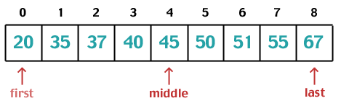
Binary search
Step2: Calculate middle = (low + high) / 2.
= (0 + 8) / 2 = 4.
If 37 == array[middle] →return middle
Else if 37 < array[middle] →high = middle -1
Else if 37 > array[middle] →low = middle +1

Slide 21
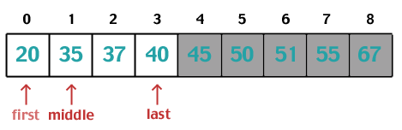
Binary search
Repeat Step 2: Calculate middle = (low + high) / 2.
= (0 + 3) / 2 = 1.
If 37 == array[middle] →return middle
Else if 37 < array[middle] →high = middle -1
Else if 37 > array[middle] →low = middle +1

Slide 22
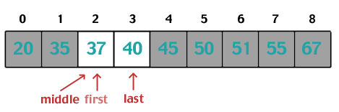
Binary search
Repeat Step 2: Calculate middle = (low + high) / 2.
= (2 + 3) / 2 = 2.
If 37 == array[middle] →return middle
Else if 37 < array[middle] →high = middle -1
Else if 37 > array[middle] →low = middle +1

Slide 23

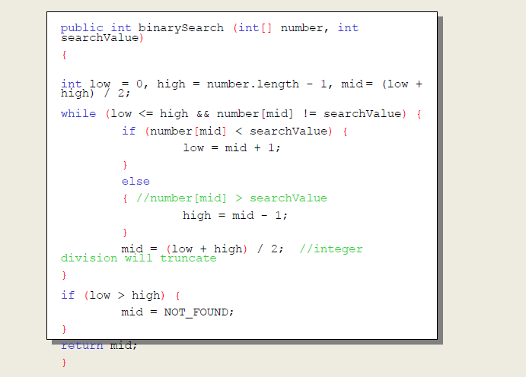
Binary search Routine

Slide 24
Binary Search Performance
Successful Search
  Best Case –1 comparison
  Worst Case –log₂N comparisons
Unsuccessful Search
  Best Case = ----
  Worst Case = log₂N comparisons
Since the portion of an array to search is cut into half after every comparison, we compute how many times the array can be divided into halves.
After K comparisons, there will be N/2^{K} elements in the list. We solve for K when N/2^{K}= 1, deriving K = log₂N.

Slide 25
Comparing N and log₂N performances
Array Size | Linear – N | Binary – log₂N
10 | 10 | 4
50 | 50 | 6
100 | 100 | 7
500 | 500 | 9
1000 | 1000 | 10
2000 | 2000 | 11
3000 | 3000 | 12
4000 | 4000 | 12
5000 | 5000 | 13
6000 | 6000 | 13
7000 | 7000 | 13
8000 | 8000 | 13
9000 | 9000 | 14
10000 | 10000 | 14

Slide 26
Important differences
Input data needs to be sorted in Binary Search and not in Linear Search
Linear search does the sequential access whereas Binary search access data randomly.
Time complexity of linear search -O(n) , Binary search has time complexity O(log n).
Linear search performs equality comparisons and Binary search performs ordering comparisons

Slide 27
Thank you

